Slide 1

SECD2523 DATABASE
SQL 4 | DML 3

Slide 2
LECTURE LEARNING OUTCOME
By the end of this lecture, students should be able to:
Construct SQL statements for data manipulations with multiple tables
01
Subqueries
02
Simple Join
03
Equijoin: NATIONAL JOIN; JOIN … ON; INNER JOIN ON;
04
Outer Join: LEFT OUTER JOIN; RIGHT OUTER JOIN; FULL OUTER JOIN;

Slide 3
01
Subqueries
02
Simple Join
03
Equijoin
04
Outer Join

Slide 4
Before we continue this DML 3,
We need to prepare our tables for all required records…
Here, our SQL statements to prepare…
https://docs.google.com/document/d/1jC5daHE4WhP7N9U6ZxqRzBJcJAzqJxf1/edit?usp=sharing&ouid=112935562328060013817&rtpof=true&sd=true

Slide 5
Create a database to create tables for employees, departments, and locations
CREATE DATABASE IF NOT EXISTS db_dml3_dept_emp_loc;
use db_dml3_dept_emp_loc;
CREATE TABLE departments (department_id INT (11) NOT NULL, department_name VARCHAR(30) NOT NULL, manager_id INT (11), location_id INT (11), PRIMARY KEY (department_id));
CREATE TABLE employees (employee_id INT (11) NOT NULL, first_name VARCHAR(20), last_name VARCHAR(25) NOT NULL, email VARCHAR(25) NOT NULL, phone_number VARCHAR(20), hire_date DATE NOT NULL, job_id VARCHAR(10) NOT NULL, salary DECIMAL(8, 2) NOT NULL, commission_pct DECIMAL(2, 2), manager_id INT (11), department_id INT (11), PRIMARY KEY (employee_id));
CREATE TABLE locations (location_id INT (11) NOT NULL, street_address VARCHAR(40), postal_code VARCHAR(12), city VARCHAR(30) NOT NULL, state_province VARCHAR(25), country_id CHAR(2) NOT NULL, PRIMARY KEY (location_id));

Slide 6
Insert into locations with the following values (23 records)
INSERT INTO locations VALUES (1000,'1297 Via Cola di Rie','00989','Roma',NULL,'IT');
INSERT INTO locations VALUES (1100,'93091 Calle della Testa','10934','Venice',NULL,'IT');
INSERT INTO locations VALUES (1200,'2017 Shinjuku-ku','1689','Tokyo','Tokyo Prefecture','JP');
INSERT INTO locations VALUES (1300,'9450 Kamiya-cho','6823','Hiroshima',NULL,'JP');
INSERT INTO locations VALUES (1400,'2014 Jabberwocky Rd','26192','Southlake','Texas','US');
INSERT INTO locations VALUES (1500,'2011 Interiors Blvd','99236','South San Francisco','California','US');
INSERT INTO locations VALUES (1600,'2007 Zagora St','50090','South Brunswick','New Jersey','US');
INSERT INTO locations VALUES (1700,'2004 Charade Rd','98199','Seattle','Washington','US');
INSERT INTO locations VALUES (1800,'147 Spadina Ave','M5V 2L7','Toronto','Ontario','CA');
INSERT INTO locations VALUES (1900,'6092 Boxwood St','YSW 9T2','Whitehorse','Yukon','CA');
INSERT INTO locations VALUES (2000,'40-5-12 Laogianggen','190518','Beijing',NULL,'CN');
INSERT INTO locations VALUES (2100,'1298 Vileparle (E)','490231','Bombay','Maharashtra','IN');
INSERT INTO locations VALUES (2200,'12-98 Victoria Street','2901','Sydney','New South Wales','AU');
INSERT INTO locations VALUES (2300,'198 Clementi North','540198','Singapore',NULL,'SG');
INSERT INTO locations VALUES (2400,'8204 Arthur St',NULL,'London',NULL,'UK');
INSERT INTO locations VALUES (2500,'Magdalen Centre, The Oxford Science Park','OX9 9ZB','Oxford','Oxford','UK');
INSERT INTO locations VALUES (2600,'9702 Chester Road','09629850293','Stretford','Manchester','UK');
INSERT INTO locations VALUES (2700,'Schwanthalerstr. 7031','80925','Munich','Bavaria','DE');
INSERT INTO locations VALUES (2800,'Rua Frei Caneca 1360 ','01307-002','Sao Paulo','Sao Paulo','BR');
INSERT INTO locations VALUES (2900,'20 Rue des Corps-Saints','1730','Geneva','Geneve','CH');
INSERT INTO locations VALUES (3000,'Murtenstrasse 921','3095','Bern','BE','CH');
INSERT INTO locations VALUES (3100,'Pieter Breughelstraat 837','3029SK','Utrecht','Utrecht','NL');
INSERT INTO locations VALUES (3200,'Mariano Escobedo 9991','11932','Mexico City','Distrito Federal,','MX');

Slide 7
Insert into departments with the following values (27 records)
INSERT INTO departments VALUES (10,'Administration',200,1700);
INSERT INTO departments VALUES (20,'Marketing',201,1800);
INSERT INTO departments VALUES (30,'Purchasing',114,1700);
INSERT INTO departments VALUES (40,'Human Resources',203,2400);
INSERT INTO departments VALUES (50,'Shipping',121,1500);
INSERT INTO departments VALUES (60,'IT',103,1400);
INSERT INTO departments VALUES (70,'Public Relations',204,2700);
INSERT INTO departments VALUES (80,'Sales',145,2500);
INSERT INTO departments VALUES (90,'Executive',100,1700);
INSERT INTO departments VALUES (100,'Finance',108,1700);
INSERT INTO departments VALUES (110,'Accounting',205,1700);
INSERT INTO departments VALUES (120,'Treasury',NULL,1700);
INSERT INTO departments VALUES (130,'Corporate Tax',NULL,1700);
INSERT INTO departments VALUES (140,'Control And Credit',NULL,1700);
INSERT INTO departments VALUES (150,'Shareholder Services',NULL,1700);
INSERT INTO departments VALUES (160,'Benefits',NULL,1700);
INSERT INTO departments VALUES (170,'Manufacturing',NULL,1700);
INSERT INTO departments VALUES (180,'Construction',NULL,1700);
INSERT INTO departments VALUES (190,'Contracting',NULL,1700);
INSERT INTO departments VALUES (200,'Operations',NULL,1700);
INSERT INTO departments VALUES (210,'IT Support',NULL,1700);
INSERT INTO departments VALUES (220,'NOC',NULL,1700);
INSERT INTO departments VALUES (230,'IT Helpdesk',NULL,1700);
INSERT INTO departments VALUES (240,'Government Sales',NULL,1700);
INSERT INTO departments VALUES (250,'Retail Sales',NULL,1700);
INSERT INTO departments VALUES (260,'Recruiting',NULL,1700);
INSERT INTO departments VALUES (270,'Payroll',NULL,1700);

Slide 8
Insert into employees with the following values (107 records)
INSERT INTO employees VALUES (100,'Steven','King','SKING','515.123.4567',STR_TO_DATE('17-JUN-1987', '%d-%M-%Y'),'AD_PRES',24000,NULL,NULL,90);
INSERT INTO employees VALUES (101,'Neena','Kochhar','NKOCHHAR','515.123.4568',STR_TO_DATE('21-SEP-1989', '%d-%M-%Y'),'AD_VP',17000,NULL,100,90);
INSERT INTO employees VALUES (102,'Lex','De Haan','LDEHAAN','515.123.4569',STR_TO_DATE('13-JAN-1993', '%d-%M-%Y'),'AD_VP',17000,NULL,100,90);
INSERT INTO employees VALUES (103,'Alexander','Hunold','AHUNOLD','590.423.4567',STR_TO_DATE('03-JAN-1990', '%d-%M-%Y'),'IT_PROG',9000,NULL,102,60);
INSERT INTO employees VALUES (104,'Bruce','Ernst','BERNST','590.423.4568',STR_TO_DATE('21-MAY-1991', '%d-%M-%Y'),'IT_PROG',6000,NULL,103,60);
INSERT INTO employees VALUES (105,'David','Austin','DAUSTIN','590.423.4569',STR_TO_DATE('25-JUN-1997', '%d-%M-%Y'),'IT_PROG',4800,NULL,103,60);
INSERT INTO employees VALUES (106,'Valli','Pataballa','VPATABAL','590.423.4560',STR_TO_DATE('05-FEB-1998', '%d-%M-%Y'),'IT_PROG',4800,NULL,103,60);
INSERT INTO employees VALUES (107,'Diana','Lorentz','DLORENTZ','590.423.5567',STR_TO_DATE('07-FEB-1999', '%d-%M-%Y'),'IT_PROG',4200,NULL,103,60);
INSERT INTO employees VALUES (108,'Nancy','Greenberg','NGREENBE','515.124.4569',STR_TO_DATE('17-AUG-1994', '%d-%M-%Y'),'FI_MGR',12000,NULL,101,100);
INSERT INTO employees VALUES (109,'Daniel','Faviet','DFAVIET','515.124.4169',STR_TO_DATE('16-AUG-1994', '%d-%M-%Y'),'FI_ACCOUNT',9000,NULL,108,100);
INSERT INTO employees VALUES (110,'John','Chen','JCHEN','515.124.4269',STR_TO_DATE('28-SEP-1997', '%d-%M-%Y'),'FI_ACCOUNT',8200,NULL,108,100);
INSERT INTO employees VALUES (111,'Ismael','Sciarra','ISCIARRA','515.124.4369',STR_TO_DATE('30-SEP-1997', '%d-%M-%Y'),'FI_ACCOUNT',7700,NULL,108,100);
INSERT INTO employees VALUES (112,'Jose Manuel','Urman','JMURMAN','515.124.4469',STR_TO_DATE('07-MAR-1998', '%d-%M-%Y'),'FI_ACCOUNT',7800,NULL,108,100);
INSERT INTO employees VALUES (113,'Luis','Popp','LPOPP','515.124.4567',STR_TO_DATE('07-DEC-1999', '%d-%M-%Y'),'FI_ACCOUNT',6900,NULL,108,100);
INSERT INTO employees VALUES (114,'Den','Raphaely','DRAPHEAL','515.127.4561',STR_TO_DATE('07-DEC-1994', '%d-%M-%Y'),'PU_MAN',11000,NULL,100,30);
INSERT INTO employees VALUES (115,'Alexander','Khoo','AKHOO','515.127.4562',STR_TO_DATE('18-MAY-1995', '%d-%M-%Y'),'PU_CLERK',3100,NULL,114,30);
INSERT INTO employees VALUES (116,'Shelli','Baida','SBAIDA','515.127.4563',STR_TO_DATE('24-DEC-1997', '%d-%M-%Y'),'PU_CLERK',2900,NULL,114,30);
INSERT INTO employees VALUES (117,'Sigal','Tobias','STOBIAS','515.127.4564',STR_TO_DATE('24-JUL-1997', '%d-%M-%Y'),'PU_CLERK',2800,NULL,114,30);
INSERT INTO employees VALUES (118,'Guy','Himuro','GHIMURO','515.127.4565',STR_TO_DATE('15-NOV-1998', '%d-%M-%Y'),'PU_CLERK',2600,NULL,114,30);
INSERT INTO employees VALUES (119,'Karen','Colmenares','KCOLMENA','515.127.4566',STR_TO_DATE('10-AUG-1999', '%d-%M-%Y'),'PU_CLERK',2500,NULL,114,30);
INSERT INTO employees VALUES (120,'Matthew','Weiss','MWEISS','650.123.1234',STR_TO_DATE('18-JUL-1996', '%d-%M-%Y'),'ST_MAN',8000,NULL,100,50);
INSERT INTO employees VALUES (121,'Adam','Fripp','AFRIPP','650.123.2234',STR_TO_DATE('10-APR-1997', '%d-%M-%Y'),'ST_MAN',8200,NULL,100,50);
INSERT INTO employees VALUES (122,'Payam','Kaufling','PKAUFLIN','650.123.3234',STR_TO_DATE('01-MAY-1995', '%d-%M-%Y'),'ST_MAN',7900,NULL,100,50);
INSERT INTO employees VALUES (123,'Shanta','Vollman','SVOLLMAN','650.123.4234',STR_TO_DATE('10-OCT-1997', '%d-%M-%Y'),'ST_MAN',6500,NULL,100,50);
INSERT INTO employees VALUES (124,'Kevin','Mourgos','KMOURGOS','650.123.5234',STR_TO_DATE('16-NOV-1999', '%d-%M-%Y'),'ST_MAN',5800,NULL,100,50);
INSERT INTO employees VALUES (125,'Julia','Nayer','JNAYER','650.124.1214',STR_TO_DATE('16-JUL-1997', '%d-%M-%Y'),'ST_CLERK',3200,NULL,120,50);
INSERT INTO employees VALUES (126,'Irene','Mikkilineni','IMIKKILI','650.124.1224',STR_TO_DATE('28-SEP-1998', '%d-%M-%Y'),'ST_CLERK',2700,NULL,120,50);
INSERT INTO employees VALUES (127,'James','Landry','JLANDRY','650.124.1334',STR_TO_DATE('14-JAN-1999', '%d-%M-%Y'),'ST_CLERK',2400,NULL,120,50);
INSERT INTO employees VALUES (128,'Steven','Markle','SMARKLE','650.124.1434',STR_TO_DATE('08-MAR-2000', '%d-%M-%Y'),'ST_CLERK',2200,NULL,120,50);
INSERT INTO employees VALUES (129,'Laura','Bissot','LBISSOT','650.124.5234',STR_TO_DATE('20-AUG-1997', '%d-%M-%Y'),'ST_CLERK',3300,NULL,121,50);
INSERT INTO employees VALUES (130,'Mozhe','Atkinson','MATKINSO','650.124.6234',STR_TO_DATE('30-OCT-1997', '%d-%M-%Y'),'ST_CLERK',2800,NULL,121,50);
INSERT INTO employees VALUES (131,'James','Marlow','JAMRLOW','650.124.7234',STR_TO_DATE('16-FEB-1997', '%d-%M-%Y'),'ST_CLERK',2500,NULL,121,50);
INSERT INTO employees VALUES (132,'TJ','Olson','TJOLSON','650.124.8234',STR_TO_DATE('10-APR-1999', '%d-%M-%Y'),'ST_CLERK',2100,NULL,121,50);
INSERT INTO employees VALUES (133,'Jason','Mallin','JMALLIN','650.127.1934',STR_TO_DATE('14-JUN-1996', '%d-%M-%Y'),'ST_CLERK',3300,NULL,122,50);
INSERT INTO employees VALUES (134,'Michael','Rogers','MROGERS','650.127.1834',STR_TO_DATE('26-AUG-1998', '%d-%M-%Y'),'ST_CLERK',2900,NULL,122,50);
INSERT INTO employees VALUES (135,'Ki','Gee','KGEE','650.127.1734',STR_TO_DATE('12-DEC-1999', '%d-%M-%Y'),'ST_CLERK',2400,NULL,122,50);
INSERT INTO employees VALUES (136,'Hazel','Philtanker','HPHILTAN','650.127.1634',STR_TO_DATE('06-FEB-2000', '%d-%M-%Y'),'ST_CLERK',2200,NULL,122,50);
INSERT INTO employees VALUES (137,'Renske','Ladwig','RLADWIG','650.121.1234',STR_TO_DATE('14-JUL-1995', '%d-%M-%Y'),'ST_CLERK',3600,NULL,123,50);
INSERT INTO employees VALUES (138,'Stephen','Stiles','SSTILES','650.121.2034',STR_TO_DATE('26-OCT-1997', '%d-%M-%Y'),'ST_CLERK',3200,NULL,123,50);
INSERT INTO employees VALUES (139,'John','Seo','JSEO','650.121.2019',STR_TO_DATE('12-FEB-1998', '%d-%M-%Y'),'ST_CLERK',2700,NULL,123,50);
INSERT INTO employees VALUES (140,'Joshua','Patel','JPATEL','650.121.1834',STR_TO_DATE('06-APR-1998', '%d-%M-%Y'),'ST_CLERK',2500,NULL,123,50);
INSERT INTO employees VALUES (141,'Trenna','Rajs','TRAJS','650.121.8009',STR_TO_DATE('17-OCT-1995', '%d-%M-%Y'),'ST_CLERK',3500,NULL,124,50);
INSERT INTO employees VALUES (142,'Curtis','Davies','CDAVIES','650.121.2994',STR_TO_DATE('29-JAN-1997', '%d-%M-%Y'),'ST_CLERK',3100,NULL,124,50);
INSERT INTO employees VALUES (143,'Randall','Matos','RMATOS','650.121.2874',STR_TO_DATE('15-MAR-1998', '%d-%M-%Y'),'ST_CLERK',2600,NULL,124,50);
INSERT INTO employees VALUES (144,'Peter','Vargas','PVARGAS','650.121.2004',STR_TO_DATE('09-JUL-1998', '%d-%M-%Y'),'ST_CLERK',2500,NULL,124,50);
INSERT INTO employees VALUES (145,'John','Russell','JRUSSEL','011.44.1344.429268',STR_TO_DATE('01-OCT-1996', '%d-%M-%Y'),'SA_MAN',14000,.4,100,80);
INSERT INTO employees VALUES (146,'Karen','Partners','KPARTNER','011.44.1344.467268',STR_TO_DATE('05-JAN-1997', '%d-%M-%Y'),'SA_MAN',13500,.3,100,80);
INSERT INTO employees VALUES (147,'Alberto','Errazuriz','AERRAZUR','011.44.1344.429278',STR_TO_DATE('10-MAR-1997', '%d-%M-%Y'),'SA_MAN',12000,.3,100,80);
INSERT INTO employees VALUES (148,'Gerald','Cambrault','GCAMBRAU','011.44.1344.619268',STR_TO_DATE('15-OCT-1999', '%d-%M-%Y'),'SA_MAN',11000,.3,100,80);
INSERT INTO employees VALUES (149,'Eleni','Zlotkey','EZLOTKEY','011.44.1344.429018',STR_TO_DATE('29-JAN-2000', '%d-%M-%Y'),'SA_MAN',10500,.2,100,80);
INSERT INTO employees VALUES (150,'Peter','Tucker','PTUCKER','011.44.1344.129268',STR_TO_DATE('30-JAN-1997', '%d-%M-%Y'),'SA_REP',10000,.3,145,80);
INSERT INTO employees VALUES (151,'David','Bernstein','DBERNSTE','011.44.1344.345268',STR_TO_DATE('24-MAR-1997', '%d-%M-%Y'),'SA_REP',9500,.25,145,80);
INSERT INTO employees VALUES (152,'Peter','Hall','PHALL','011.44.1344.478968',STR_TO_DATE('20-AUG-1997', '%d-%M-%Y'),'SA_REP',9000,.25,145,80);
INSERT INTO employees VALUES (153,'Christopher','Olsen','COLSEN','011.44.1344.498718',STR_TO_DATE('30-MAR-1998', '%d-%M-%Y'),'SA_REP',8000,.2,145,80);
INSERT INTO employees VALUES (154,'Nanette','Cambrault','NCAMBRAU','011.44.1344.987668',STR_TO_DATE('09-DEC-1998', '%d-%M-%Y'),'SA_REP',7500,.2,145,80);
INSERT INTO employees VALUES (155,'Oliver','Tuvault','OTUVAULT','011.44.1344.486508',STR_TO_DATE('23-NOV-1999', '%d-%M-%Y'),'SA_REP',7000,.15,145,80);
INSERT INTO employees VALUES (156,'Janette','King','JKING','011.44.1345.429268',STR_TO_DATE('30-JAN-1996', '%d-%M-%Y'),'SA_REP',10000,.35,146,80);
INSERT INTO employees VALUES (157,'Patrick','Sully','PSULLY','011.44.1345.929268',STR_TO_DATE('04-MAR-1996', '%d-%M-%Y'),'SA_REP',9500,.35,146,80);
INSERT INTO employees VALUES (158,'Allan','McEwen','AMCEWEN','011.44.1345.829268',STR_TO_DATE('01-AUG-1996', '%d-%M-%Y'),'SA_REP',9000,.35,146,80);
INSERT INTO employees VALUES (159,'Lindsey','Smith','LSMITH','011.44.1345.729268',STR_TO_DATE('10-MAR-1997', '%d-%M-%Y'),'SA_REP',8000,.3,146,80);
INSERT INTO employees VALUES (160,'Louise','Doran','LDORAN','011.44.1345.629268',STR_TO_DATE('15-DEC-1997', '%d-%M-%Y'),'SA_REP',7500,.3,146,80);
INSERT INTO employees VALUES (161,'Sarath','Sewall','SSEWALL','011.44.1345.529268',STR_TO_DATE('03-NOV-1998', '%d-%M-%Y'),'SA_REP',7000,.25,146,80);
INSERT INTO employees VALUES (162,'Clara','Vishney','CVISHNEY','011.44.1346.129268',STR_TO_DATE('11-NOV-1997', '%d-%M-%Y'),'SA_REP',10500,.25,147,80);
INSERT INTO employees VALUES (163,'Danielle','Greene','DGREENE','011.44.1346.229268',STR_TO_DATE('19-MAR-1999', '%d-%M-%Y'),'SA_REP',9500,.15,147,80);
INSERT INTO employees VALUES (164,'Mattea','Marvins','MMARVINS','011.44.1346.329268',STR_TO_DATE('24-JAN-2000', '%d-%M-%Y'),'SA_REP',7200,.10,147,80);
INSERT INTO employees VALUES (165,'David','Lee','DLEE','011.44.1346.529268',STR_TO_DATE('23-FEB-2000', '%d-%M-%Y'),'SA_REP',6800,.1,147,80);
INSERT INTO employees VALUES (166,'Sundar','Ande','SANDE','011.44.1346.629268',STR_TO_DATE('24-MAR-2000', '%d-%M-%Y'),'SA_REP',6400,.10,147,80);
INSERT INTO employees VALUES (167,'Amit','Banda','ABANDA','011.44.1346.729268',STR_TO_DATE('21-APR-2000', '%d-%M-%Y'),'SA_REP',6200,.10,147,80);
INSERT INTO employees VALUES (168,'Lisa','Ozer','LOZER','011.44.1343.929268',STR_TO_DATE('11-MAR-1997', '%d-%M-%Y'),'SA_REP',11500,.25,148,80);
INSERT INTO employees VALUES (169,'Harrison','Bloom','HBLOOM','011.44.1343.829268',STR_TO_DATE('23-MAR-1998', '%d-%M-%Y'),'SA_REP',10000,.20,148,80);
INSERT INTO employees VALUES (170,'Tayler','Fox','TFOX','011.44.1343.729268',STR_TO_DATE('24-JAN-1998', '%d-%M-%Y'),'SA_REP',9600,.20,148,80);
INSERT INTO employees VALUES (171,'William','Smith','WSMITH','011.44.1343.629268',STR_TO_DATE('23-FEB-1999', '%d-%M-%Y'),'SA_REP',7400,.15,148,80);
INSERT INTO employees VALUES (172,'Elizabeth','Bates','EBATES','011.44.1343.529268',STR_TO_DATE('24-MAR-1999', '%d-%M-%Y'),'SA_REP',7300,.15,148,80);
INSERT INTO employees VALUES (173,'Sundita','Kumar','SKUMAR','011.44.1343.329268',STR_TO_DATE('21-APR-2000', '%d-%M-%Y'),'SA_REP',6100,.10,148,80);
INSERT INTO employees VALUES (174,'Ellen','Abel','EABEL','011.44.1644.429267',STR_TO_DATE('11-MAY-1996', '%d-%M-%Y'),'SA_REP',11000,.30,149,80);
INSERT INTO employees VALUES (175,'Alyssa','Hutton','AHUTTON','011.44.1644.429266',STR_TO_DATE('19-MAR-1997', '%d-%M-%Y'),'SA_REP',8800,.25,149,80);
INSERT INTO employees VALUES (176,'Jonathon','Taylor','JTAYLOR','011.44.1644.429265',STR_TO_DATE('24-MAR-1998', '%d-%M-%Y'),'SA_REP',8600,.20,149,80);
INSERT INTO employees VALUES (177,'Jack','Livingston','JLIVINGS','011.44.1644.429264',STR_TO_DATE('23-APR-1998', '%d-%M-%Y'),'SA_REP',8400,.20,149,80);
INSERT INTO employees VALUES (178,'Kimberely','Grant','KGRANT','011.44.1644.429263',STR_TO_DATE('24-MAY-1999', '%d-%M-%Y'),'SA_REP',7000,.15,149,NULL);
INSERT INTO employees VALUES (179,'Charles','Johnson','CJOHNSON','011.44.1644.429262',STR_TO_DATE('04-JAN-2000', '%d-%M-%Y'),'SA_REP',6200,.10,149,80);
INSERT INTO employees VALUES (180,'Winston','Taylor','WTAYLOR','650.507.9876',STR_TO_DATE('24-JAN-1998', '%d-%M-%Y'),'SH_CLERK',3200,NULL,120,50);
INSERT INTO employees VALUES (181,'Jean','Fleaur','JFLEAUR','650.507.9877',STR_TO_DATE('23-FEB-1998', '%d-%M-%Y'),'SH_CLERK',3100,NULL,120,50);
INSERT INTO employees VALUES (182,'Martha','Sullivan','MSULLIVA','650.507.9878',STR_TO_DATE('21-JUN-1999', '%d-%M-%Y'),'SH_CLERK',2500,NULL,120,50);
INSERT INTO employees VALUES (183,'Girard','Geoni','GGEONI','650.507.9879',STR_TO_DATE('03-FEB-2000', '%d-%M-%Y'),'SH_CLERK',2800,NULL,120,50);
INSERT INTO employees VALUES (184,'Nandita','Sarchand','NSARCHAN','650.509.1876',STR_TO_DATE('27-JAN-1996', '%d-%M-%Y'),'SH_CLERK',4200,NULL,121,50);
INSERT INTO employees VALUES (185,'Alexis','Bull','ABULL','650.509.2876',STR_TO_DATE('20-FEB-1997', '%d-%M-%Y'),'SH_CLERK',4100,NULL,121,50);
INSERT INTO employees VALUES (186,'Julia','Dellinger','JDELLING','650.509.3876',STR_TO_DATE('24-JUN-1998', '%d-%M-%Y'),'SH_CLERK',3400,NULL,121,50);
INSERT INTO employees VALUES (187,'Anthony','Cabrio','ACABRIO','650.509.4876',STR_TO_DATE('07-FEB-1999', '%d-%M-%Y'),'SH_CLERK',3000,NULL,121,50);
INSERT INTO employees VALUES (188,'Kelly','Chung','KCHUNG','650.505.1876',STR_TO_DATE('14-JUN-1997', '%d-%M-%Y'),'SH_CLERK',3800,NULL,122,50);
INSERT INTO employees VALUES (189,'Jennifer','Dilly','JDILLY','650.505.2876',STR_TO_DATE('13-AUG-1997', '%d-%M-%Y'),'SH_CLERK',3600,NULL,122,50);
INSERT INTO employees VALUES (190,'Timothy','Gates','TGATES','650.505.3876',STR_TO_DATE('11-JUL-1998', '%d-%M-%Y'),'SH_CLERK',2900,NULL,122,50);
INSERT INTO employees VALUES (191,'Randall','Perkins','RPERKINS','650.505.4876',STR_TO_DATE('19-DEC-1999', '%d-%M-%Y'),'SH_CLERK',2500,NULL,122,50);
INSERT INTO employees VALUES (192,'Sarah','Bell','SBELL','650.501.1876',STR_TO_DATE('04-FEB-1996', '%d-%M-%Y'),'SH_CLERK',4000,NULL,123,50);
INSERT INTO employees VALUES (193,'Britney','Everett','BEVERETT','650.501.2876',STR_TO_DATE('03-MAR-1997', '%d-%M-%Y'),'SH_CLERK',3900,NULL,123,50);
INSERT INTO employees VALUES (194,'Samuel','McCain','SMCCAIN','650.501.3876',STR_TO_DATE('01-JUL-1998', '%d-%M-%Y'),'SH_CLERK',3200,NULL,123,50);
INSERT INTO employees VALUES (195,'Vance','Jones','VJONES','650.501.4876',STR_TO_DATE('17-MAR-1999', '%d-%M-%Y'),'SH_CLERK',2800,NULL,123,50);
INSERT INTO employees VALUES (196,'Alana','Walsh','AWALSH','650.507.9811',STR_TO_DATE('24-APR-1998', '%d-%M-%Y'),'SH_CLERK',3100,NULL,124,50);
INSERT INTO employees VALUES (197,'Kevin','Feeney','KFEENEY','650.507.9822',STR_TO_DATE('23-MAY-1998', '%d-%M-%Y'),'SH_CLERK',3000,NULL,124,50);
INSERT INTO employees VALUES (198,'Donald','OConnell','DOCONNEL','650.507.9833',STR_TO_DATE('21-JUN-1999', '%d-%M-%Y'),'SH_CLERK',2600,NULL,124,50);
INSERT INTO employees VALUES (199,'Douglas','Grant','DGRANT','650.507.9844',STR_TO_DATE('13-JAN-2000', '%d-%M-%Y'),'SH_CLERK',2600,NULL,124,50);
INSERT INTO employees VALUES (200,'Jennifer','Whalen','JWHALEN','515.123.4444',STR_TO_DATE('17-SEP-1987', '%d-%M-%Y'),'AD_ASST',4400,NULL,101,10);
INSERT INTO employees VALUES (201,'Michael','Hartstein','MHARTSTE','515.123.5555',STR_TO_DATE('17-FEB-1996', '%d-%M-%Y'),'MK_MAN',13000,NULL,100,20);
INSERT INTO employees VALUES (202,'Pat','Fay','PFAY','603.123.6666',STR_TO_DATE('17-AUG-1997', '%d-%M-%Y'),'MK_REP',6000,NULL,201,20);
INSERT INTO employees VALUES (203,'Susan','Mavris','SMAVRIS','515.123.7777',STR_TO_DATE('07-JUN-1994', '%d-%M-%Y'),'HR_REP',6500,NULL,101,40);
INSERT INTO employees VALUES (204,'Hermann','Baer','HBAER','515.123.8888',STR_TO_DATE('07-JUN-1994', '%d-%M-%Y'),'PR_REP',10000,NULL,101,70);
INSERT INTO employees VALUES (205,'Shelley','Higgins','SHIGGINS','515.123.8080',STR_TO_DATE('07-JUN-1994', '%d-%M-%Y'),'AC_MGR',12000,NULL,101,110);
INSERT INTO employees VALUES (206,'William','Gietz','WGIETZ','51hr5.123.8181',STR_TO_DATE('07-JUN-1994', '%d-%M-%Y'),'AC_ACCOUNT',8300,NULL,205,110);

Slide 9
Now, we need to add foreign keys to tables departments and employees
ALTER TABLE departments ADD FOREIGN KEY (location_id) REFERENCES locations(location_id);
ALTER TABLE employees ADD FOREIGN KEY (department_id) REFERENCES departments(department_id);
ALTER TABLE employees ADD FOREIGN KEY (manager_id) REFERENCES employees(employee_id);
ALTER TABLE departments ADD FOREIGN KEY (manager_id) REFERENCES employees (employee_id);

Slide 10
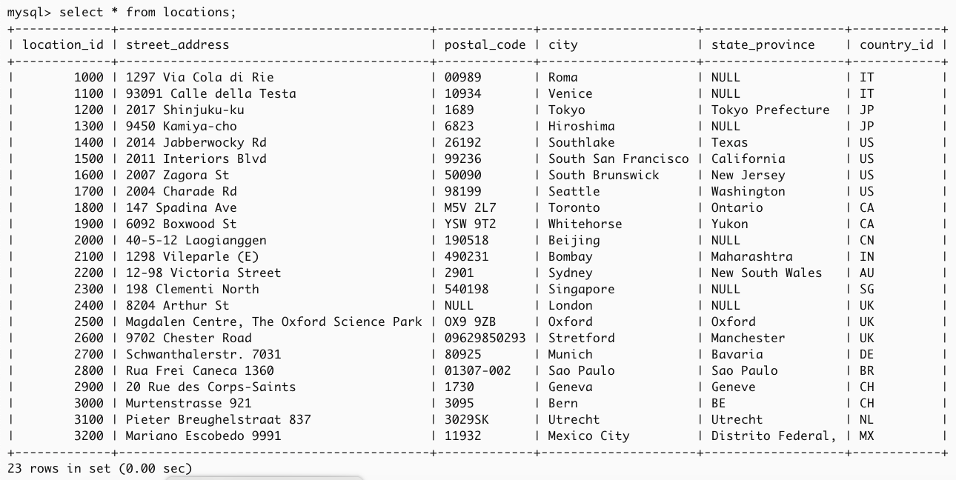
Here, our tables with records
select * from locations;

Slide 11
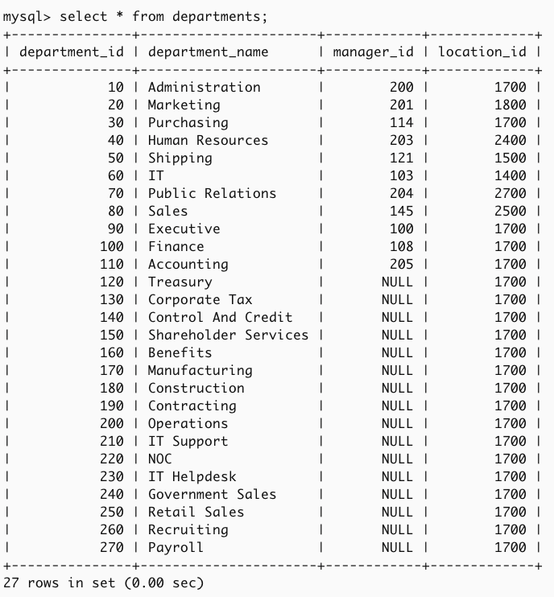
Here, our tables with records
select * from departments;

Slide 12
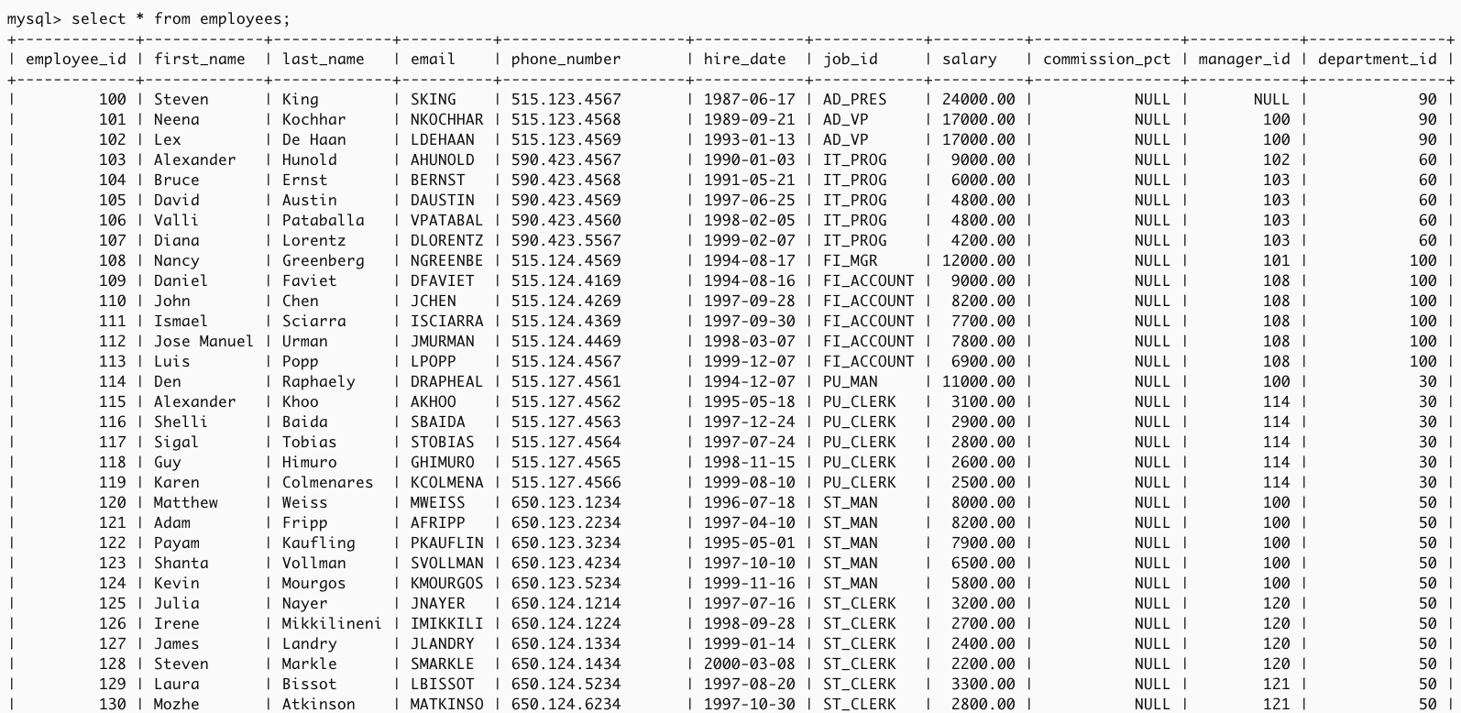
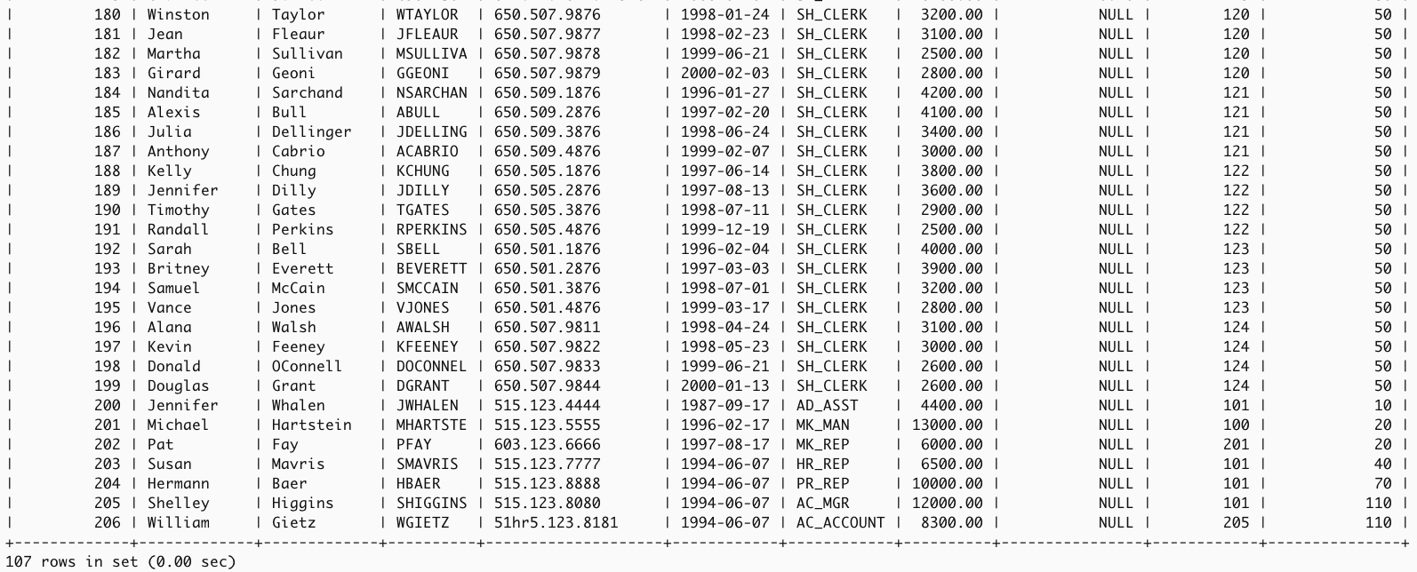
Here, our tables with records
select * from employees;

Slide 13
Subqueries

Slide 14
Subqueries
Nested query
  Contains outer & inner SELECT statements.
  The result of inner SELECT (subquery) is used by the outer query to determine the final output.
  Subqueries written at:
    WHERE or HAVING clause
    SELECT or FROM clause
  When subquery written at SELECT clause, the subquery output is a single value.

Slide 15
Subqueries
Example 1:
  List employee id and salary of all
  employees who are working in the
  sales department.
SELECT employee_id, salary
FROM employees
WHERE department_id =
( SELECT department_id
FROM departments
WHERE department_name = 'Sales' );

Slide 16
Subqueries
What if we want also to display the department name in the result? How should the statement be written?
Will this query execute correctly???
SELECT employee_id, salary, department_name
FROM employees
WHERE department_id =
( SELECT department_id
FROM departments
WHERE department_name = 'Sales') ;

Slide 17
Subqueries
What if we want also to display the department name in the result? How should the statement be written?
Will this query execute correctly??? No
SELECT employee_id, salary, department_name
FROM employees
WHERE department_id =
( SELECT department_id
FROM departments
WHERE department_name = 'Sales') ;

Slide 18
Join

Slide 19
Obtaining Data From Multiple Tables
Sometimes you need to use and display data from more than one table.
  Employee IDs exist in the EMPLOYEES table.
  Department IDs exist in both the EMPLOYEES and DEPARTMENTS tables.
  Department names exist in the DEPARTMENTS table.
To produce the report, you need to join the EMPLOYEES and DEPARTMENTS tables, and access data from both of them.

Slide 20
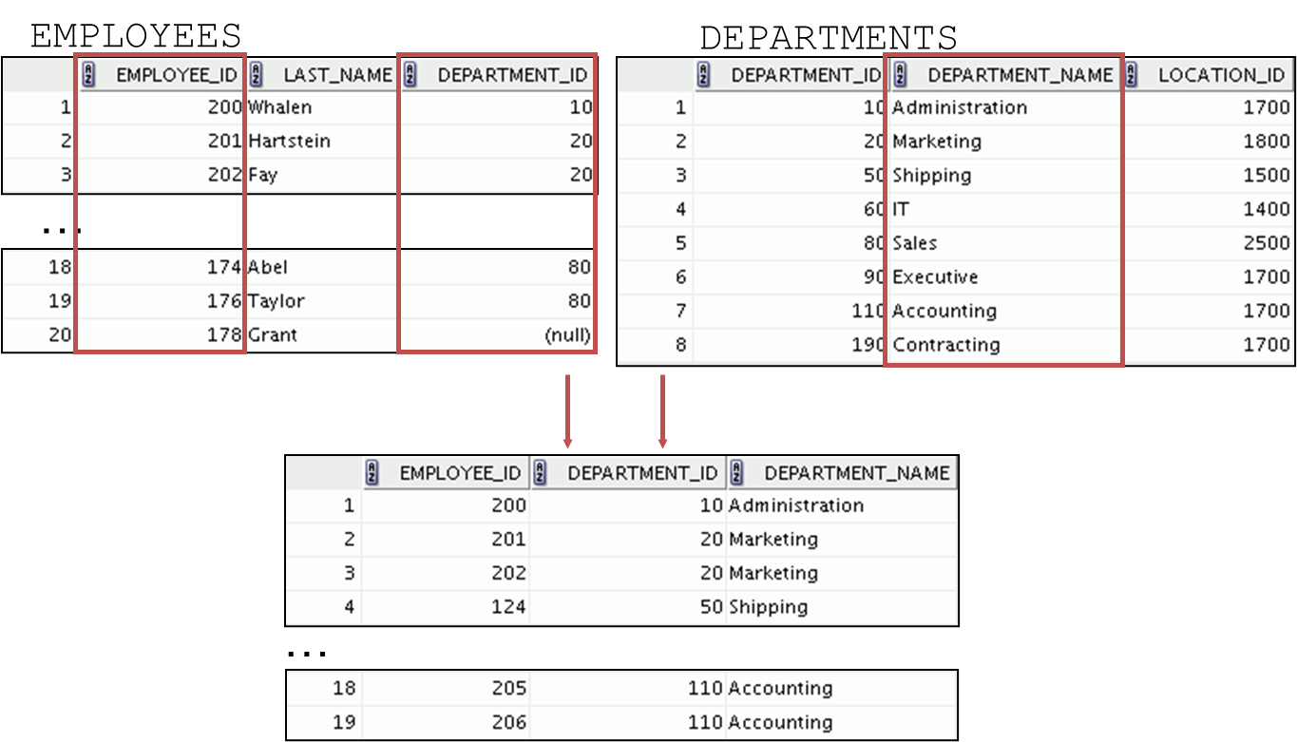
Obtaining Data From Multiple Tables

Slide 21
Simple Join / Traditional Method
Query 1:
List the employee first name, last name and employee salary for the SALES department.
SELECT first_name, last_name, salary
FROM employees, departments
WHERE employees.department_id = departments.department_id
AND departments.department_name = 'Sales';
This is a simple join
*without the use of any special syntax in SQL

Slide 22
Simple Join / Traditional Method
Query 2:
List all employees id, first name, last name and department name.
SELECT employee_id, first_name, last_name, department_name
FROM employees, departments
WHERE employees.department_id = departments.department_id;

Slide 23
Simple Join / Traditional Method
Query 3:
List all employee id, first name, last name, department id and department name.
SELECT employee_id, first_name, last_name, department_name, department_id
FROM employees, departments
WHERE employees.department_id = departments.department_id;
Why error occur?
How to correct the error?

Slide 24
Simple Join / Traditional Method
Query 3:
List all employee id, first name, last name, department id and department name.
SELECT employee_id, first_name, last_name, department_name, employees.department_id
FROM employees, departments
WHERE employees.department_id = departments.department_id;
To solve the ambiguous column issue,
use Table prefix to correct the error

Slide 25
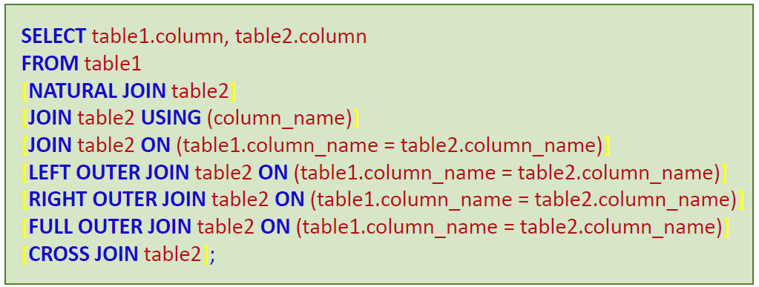
Joining Tables Using SQL:1999 syntax
Use a join to query data from more than one table:
[ ] = optional

Slide 26
Equijoins
That is where a column (or multiple columns) in two or more tables match
Can write using:
  Simple join:
    SELECT…FROM…WHERE
  ANSI syntax:
    NATURAL JOIN
    JOIN…USING
    JOIN…ON
    INNER JOIN…ON

Slide 27
Natural Join

Slide 28
Using NATURAL JOIN
The NATURAL JOIN clause is based on all columns in the two tables that have the same name.
It selects rows from the two tables that have equal values in all matched columns.
If the columns having the same names have different data types, an error is returned.

Slide 29
Using NATURAL JOIN
Query 2:
List all employees id, first name, last name and department name.
SELECT employee_id, first_name, last_name, department_name
FROM employees
NATURAL JOIN departments;

Slide 30
Using NATURAL JOIN
Query 3:
List all employee id, first name, last name, department id and department name.
SELECT employee_id, first_name, last_name, department_name, department_id
FROM employees
NATURAL JOIN departments;

Slide 31
Using NATURAL JOIN
Query 4:
List all employee id, first name, last name, department name and department location id.
SELECT employee_id, first_name, last_name, department_name, location_id
FROM employees
NATURAL JOIN departments;

Slide 32
Using NATURAL JOIN
Query 4b:
List all employee id, first name, last name, department name and city.
SELECT employee_id, first_name, last_name, department_name, city
FROM employees
NATURAL JOIN departments
NATURAL JOIN locations;
Natural join with multiple tables

Slide 33
Join … Using
Join … On

Slide 34
Using JOIN…USING clause
If several columns have the same names but the data types do not match, use the USING clause to specify the columns for the equijoin.
Use the USING clause to match only one column when more than one column matches.

Slide 35
Using JOIN…USING clause
Query 3:
List all employee id, first name, last name, department id and department name.
SELECT employee_id, first_name, last_name, department_id, department_name
FROM employees
JOIN departments
USING (department_id);
Join based on the department_id attribute

Slide 36
Using JOIN…ON clause
The JOIN condition for the NATURAL JOIN is basically an equijoin of all columns with the same name.
Use the ON clause to specify arbitrary conditions or specify columns to join.
The join condition is separated from other search conditions.
The ON clause makes code easy to understand.

Slide 37
Using JOIN…ON clause
Query 3:
List all employee id, first name, last name, department id and department name.
SELECT employee_id, first_name, last_name, employees.department_id, department_name
FROM employees
JOIN departments
ON (employees.department_id = departments.department_id);

Slide 38
Using JOIN…ON clause
Query 4:
List all employee id, first name, last name, department name and department location id.
SELECT employee_id, first_name, last_name, department_name, location_id
FROM employees
JOIN departments
ON (employees.department_id = departments.department_id);

Slide 39
Using JOIN…ON clause
Query 4b:
List all employee id, first name, last name, department name and city.
SELECT employee_id, first_name, last_name, department_name, city
FROM employees e
JOIN departments d
ON e.department_id = d.department_id
JOIN locations l
ON d.location_id = l.location_id;
Using JOIN…ON with multiple tables

Slide 40
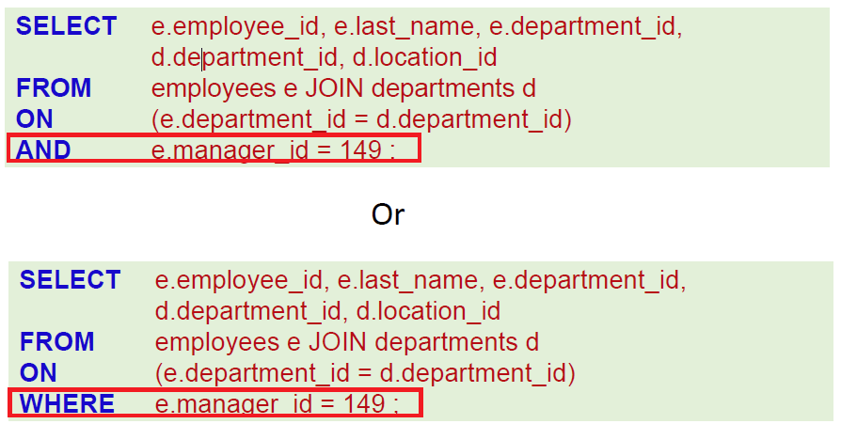
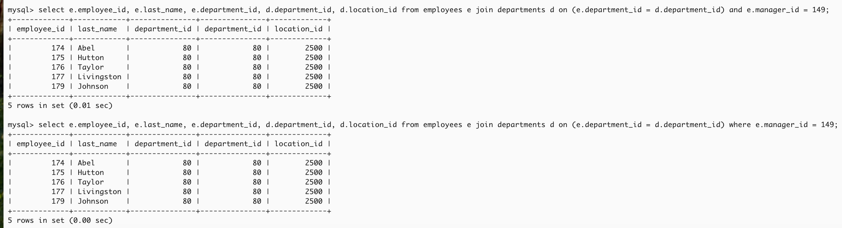
Applying Additional Conditions to a Join
Use the AND clause or the WHERE clause to apply additional conditions:
Notes:
select e.employee_id, e.last_name, e.department_id, d.department_id, d.location_id from employees e join departments d on (e.department_id = d.department_id) and e.manager_id = 149;
or
select e.employee_id, e.last_name, e.department_id, d.department_id, d.location_id from employees e join departments d on (e.department_id = d.department_id) where e.manager_id = 149;

Slide 41
Self Join
A self join is a special form of equijoin or INNER JOIN where a table is joined against itself.
This means that the table must exists two times in the FROM clause of the SQL query.
Note that when joining a table to itself an alias must be used for each of the tables in the FROM clause and then also used in the select list and WHERE clause

Slide 42
Inner Join … On

Slide 43
Self join using INNER JOIN…ON
Query 5:
List all employee id, first name, last name and their manager’s id and first name, last name.
SELECT e.employee_id, e.first_name, e.last_name, m.employee_id MANAGER_ID, m.first_name MANAGER_FNAME, m.last_name MANAGER_LNAME
FROM employees e
INNER JOIN employees m
ON e.manager_id = m.employee_id;

Slide 44
Self join using INNER JOIN…ON
Query 5:
List all employee id, first name, last name and their manager’s id and first name, last name.
SELECT e.employee_id, e.first_name, e.last_name, m.employee_id MANAGER_ID, m.first_name MANAGER_FNAME, m.last_name MANAGER_LNAME
FROM employees e
JOIN employees m
ON e.manager_id = m.employee_id;
JOIN and INNER JOIN are functionally equivalent

Slide 45
Self join using INNER JOIN…ON
Query 6:
List all employee who are the manager.
SELECT DISTINCT e.manager_id, m.first_name, m.last_name
FROM employees e
INNER JOIN employees m
ON e.manager_id = m.employee_id;

Slide 46
Using INNER JOIN…ON
Query 3:
List all employee id, first name, last name, department id and department name.
SELECT employee_id, first_name, last_name, employees.department_id, department_name
FROM employees
INNER JOIN departments
ON (employees.department_id = departments.department_id);

Slide 47
Using INNER JOIN…ON
Query 4:
List all employee id, first name, last name, department name and department location id.
SELECT employee_id, first_name, last_name, department_name, location_id
FROM employees
INNER JOIN departments
ON (employees.department_id = departments.department_id);

Slide 48
Outer Join

Slide 49
OUTER JOIN
Often times we need to return rows from one table even if there are no matching rows that are produced through a join condition. For this situation, we use outer joins.
Outer joins:
  LEFT OUTER JOIN
  RIGHT OUTER JOIN
  FULL OUTER JOIN

Slide 50
LEFT OUTER JOIN
A left outer join is where the table, on the left of a FROM clause is required to return all of its rows regardless of having matching rows from the table it is being joined on.

Slide 51
Using LEFT OUTER JOIN
Query 7:
List all department with all its employees, including all department without employee.
SELECT department_name, first_name
FROM departments
LEFT OUTER JOIN employees
ON (departments.department_id = employees.department_id);

Slide 52
RIGHT OUTER JOIN
A right outer join is just the opposite of a left outer join. It states that you would like all rows from the right table in the FROM clause to be returned regardless of having a true match defined in the WHERE clause against the left side table in the FROM clause.

Slide 53
Using RIGHT OUTER JOIN
Query 8:
List all employees with their departments, including all employees without department.
SELECT department_name, first_name
FROM departments
RIGHT OUTER JOIN employees
ON (departments.department_id = employees.department_id);

Slide 54
FULL OUTER JOIN
Return both left and right sides of a query regardless of having a match.
Note:
MySQL does not directly support a FULL OUTER JOIN.
However, you can achieve the same result
by combining a LEFT JOIN and a RIGHT JOIN with a UNION operator.

Slide 55
Using FULL OUTER JOIN
How can we get the records for all employees AND all departments whether they are missing data or not?
ORACLE:
SELECT departments.department_name, employees.first_name
FROM departments
FULL OUTER JOIN employees
ON (departments.department_id = employees.department_id);
MySQL:
SELECT departments.department_name, employees.first_name
FROM departments
LEFT JOIN employees ON departments.department_id = employees.department_id
UNION
SELECT departments.department_name, employees.first_name
FROM departments
RIGHT JOIN employees ON departments.department_id = employees.department_id;

Slide 56


